Slide 1
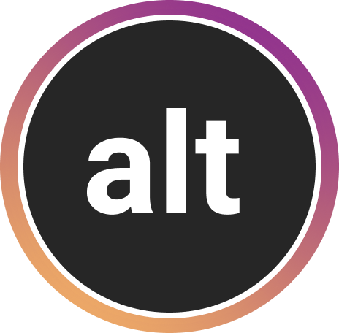
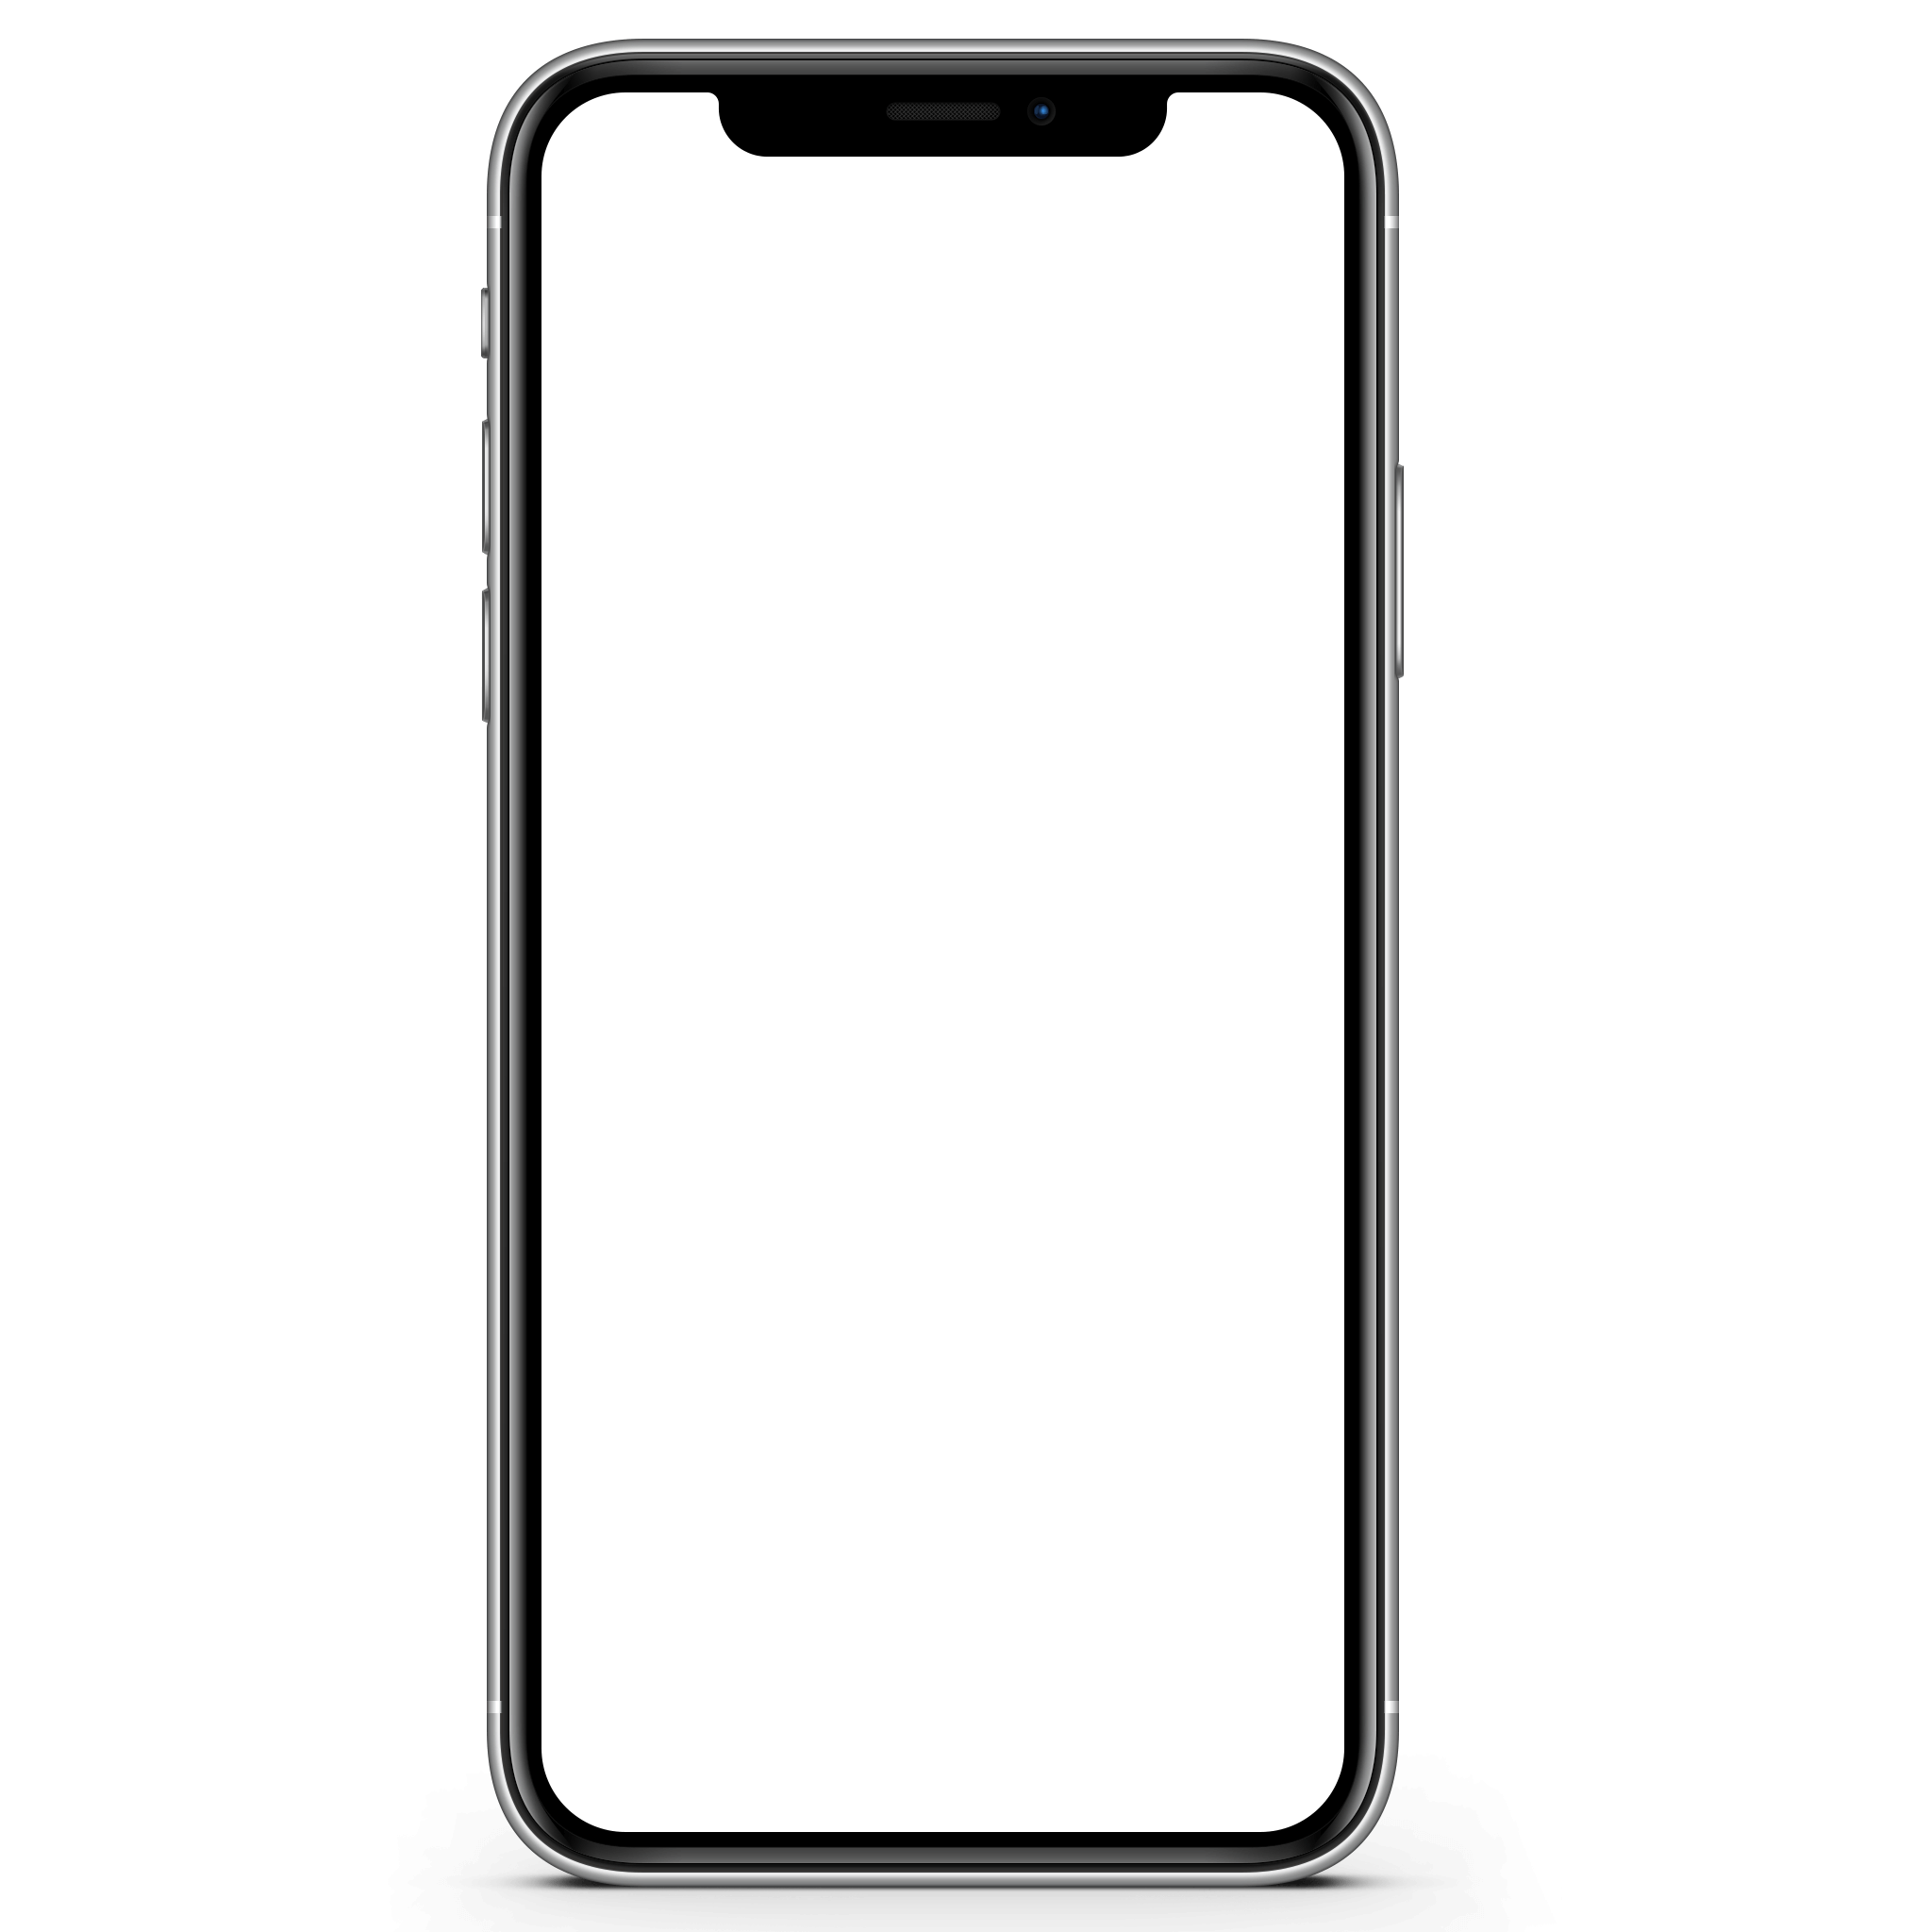
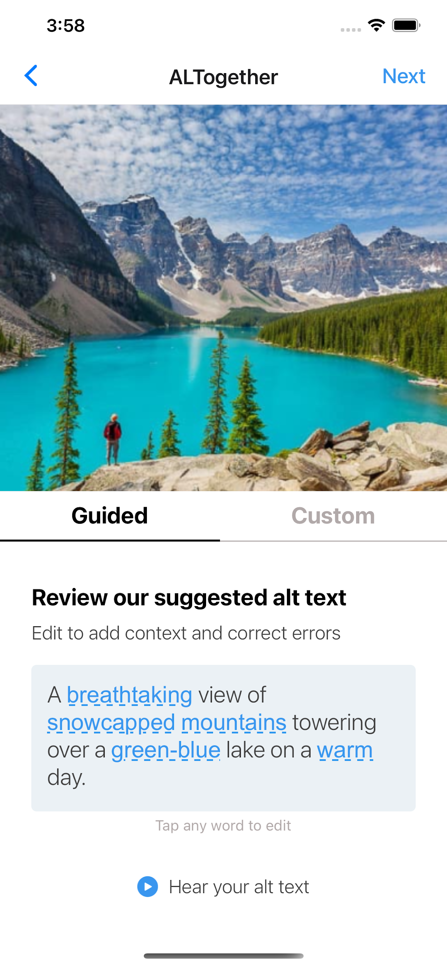
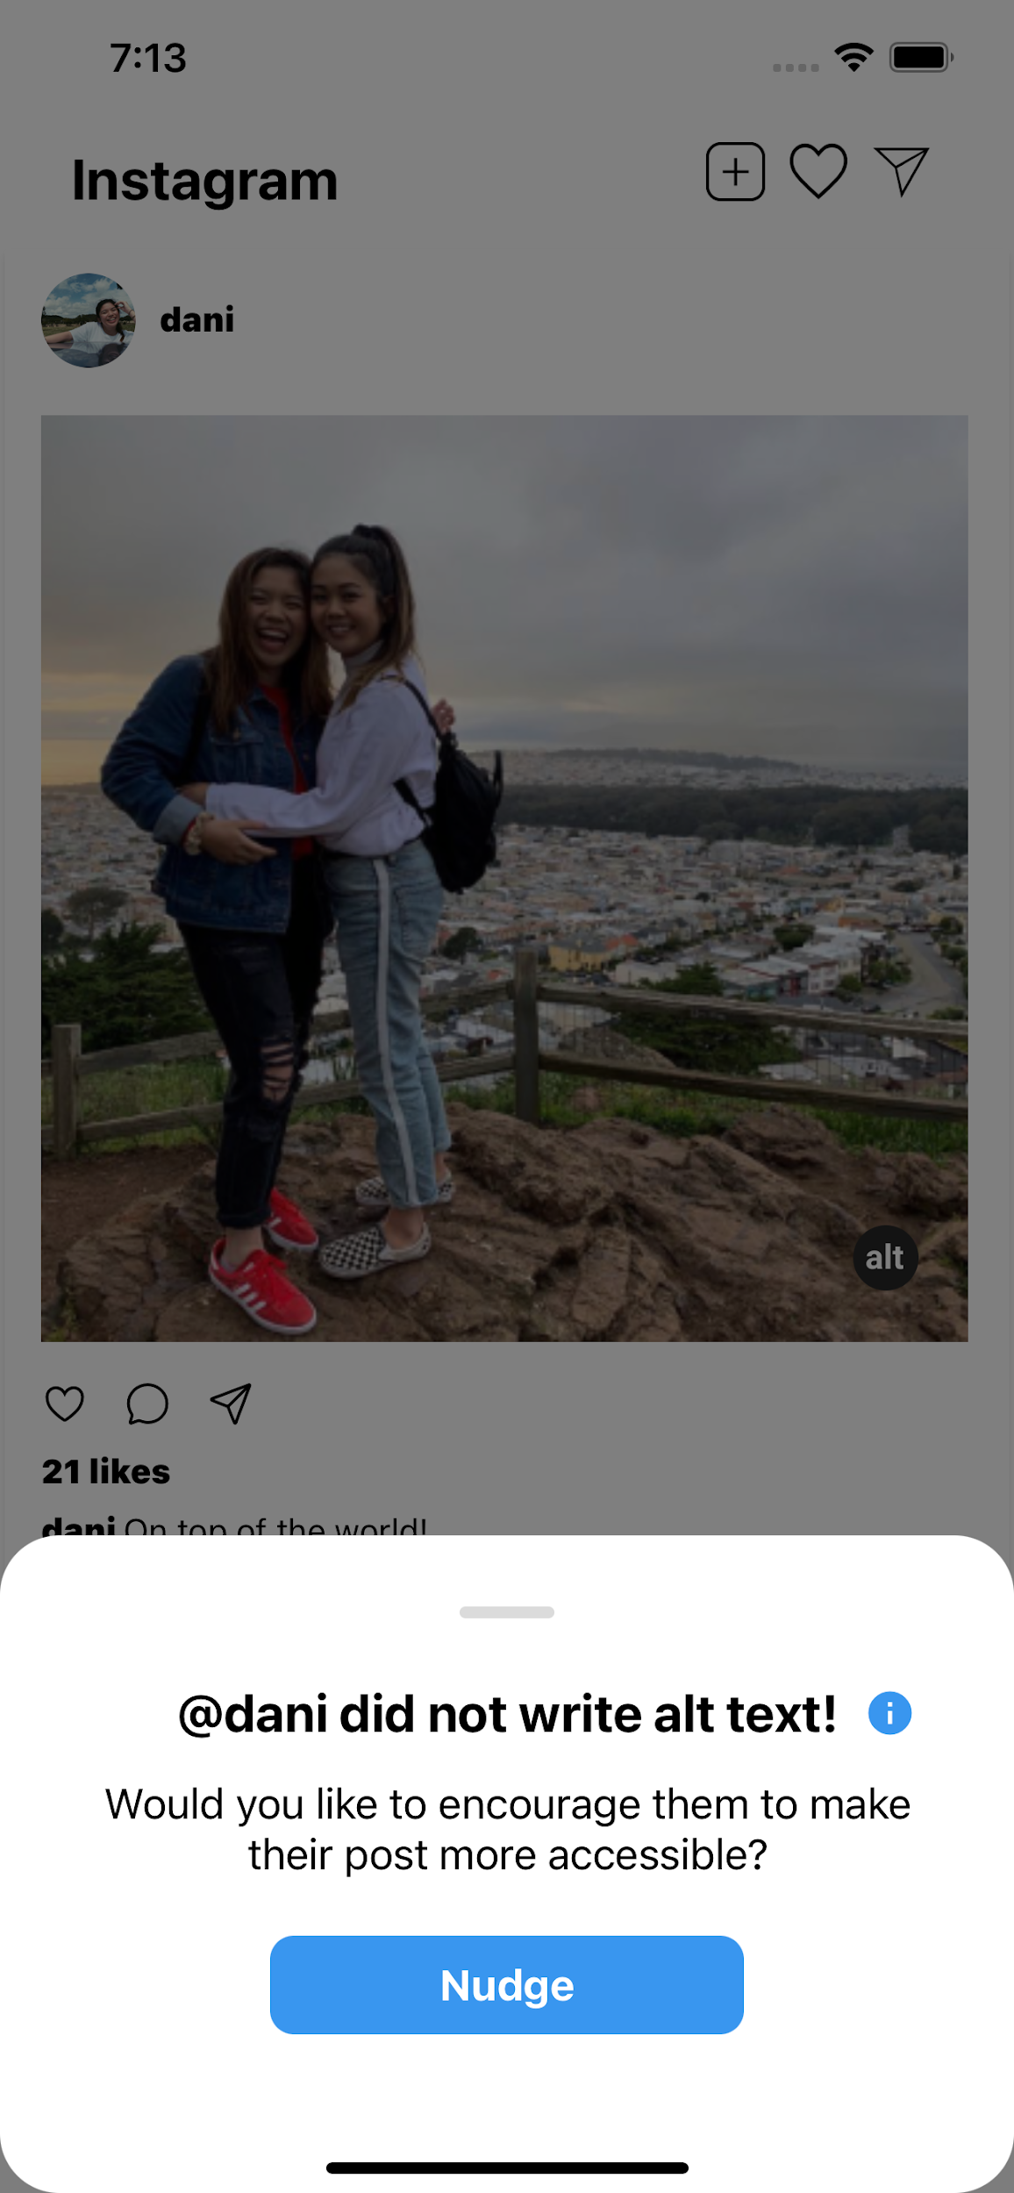
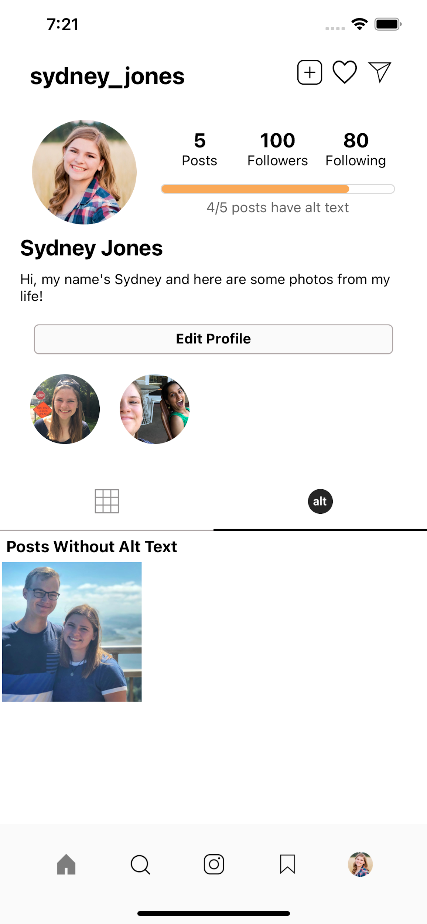
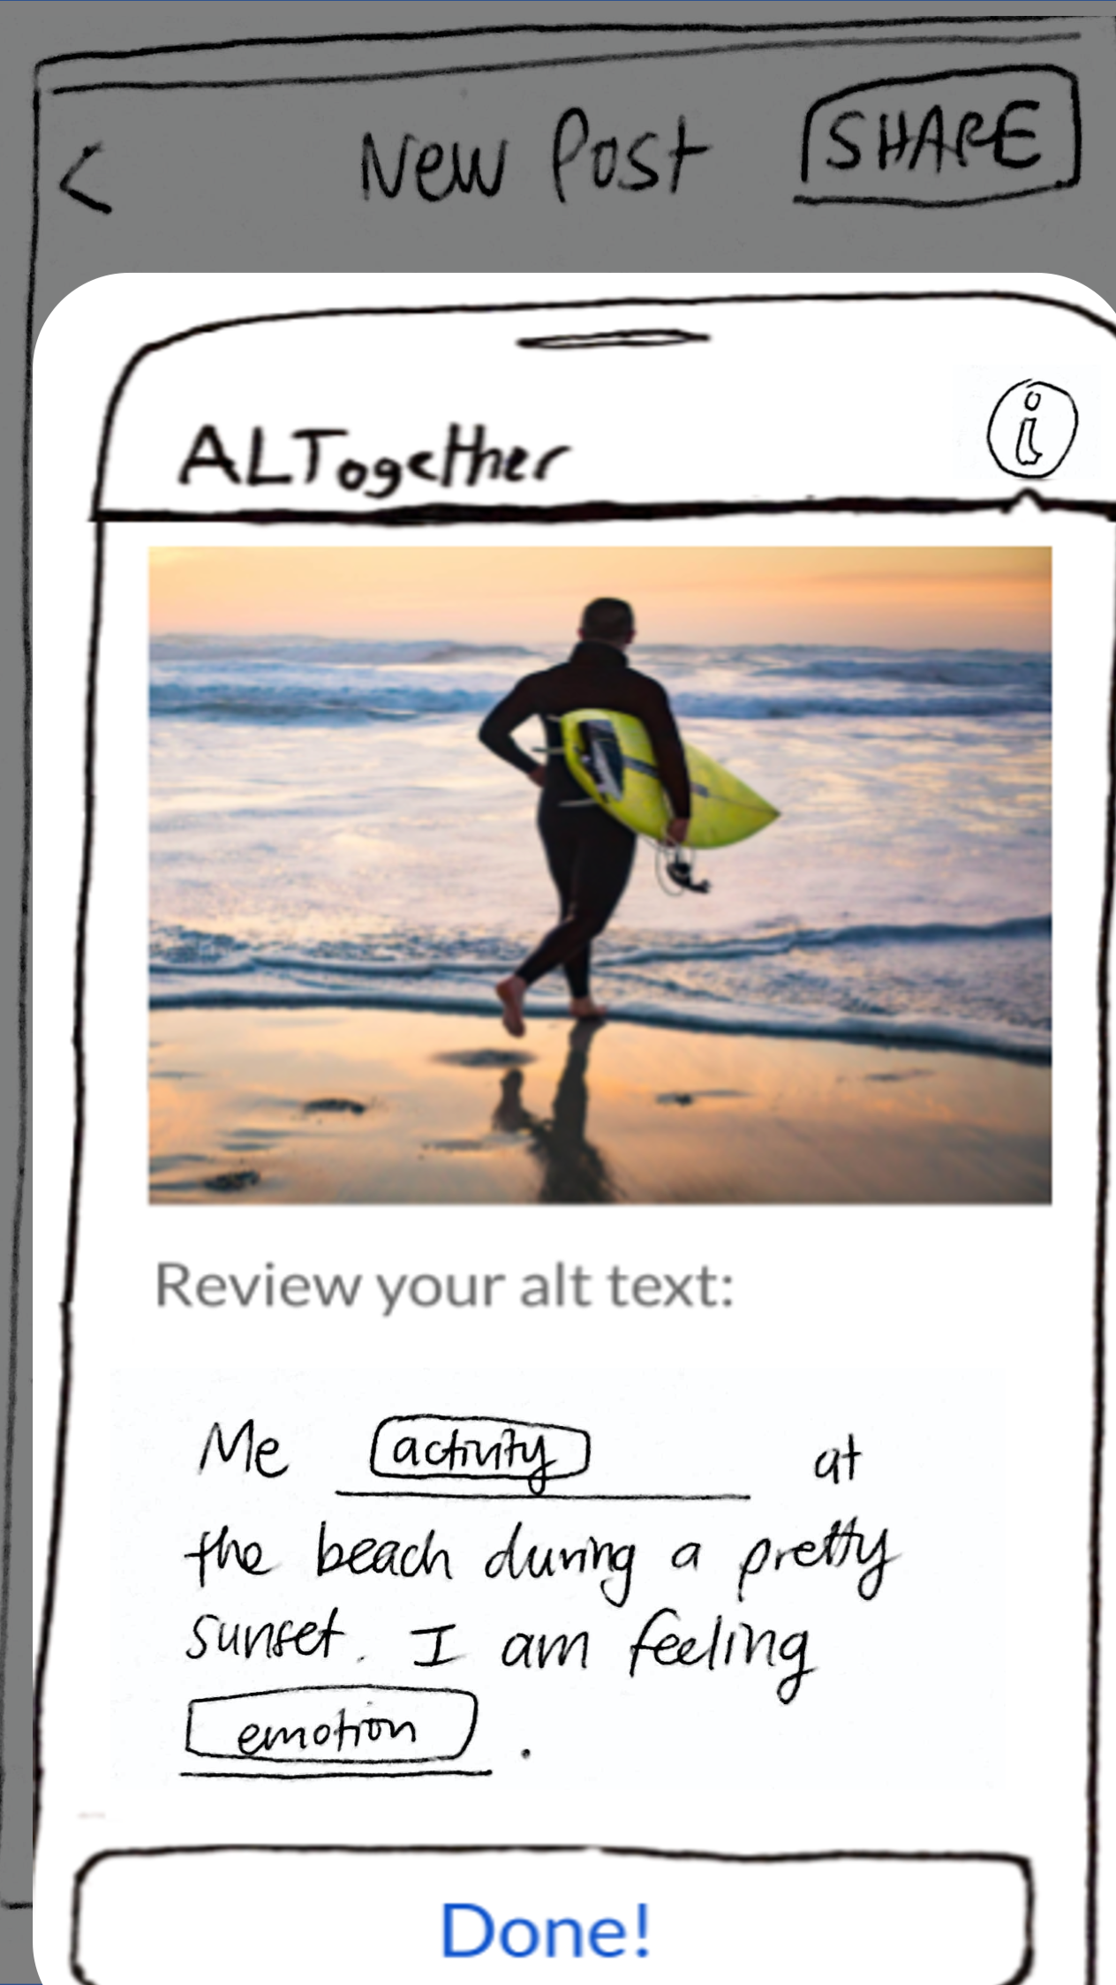
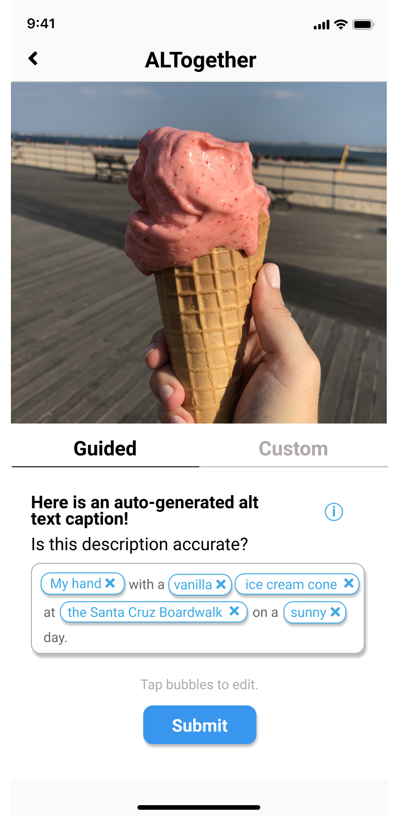
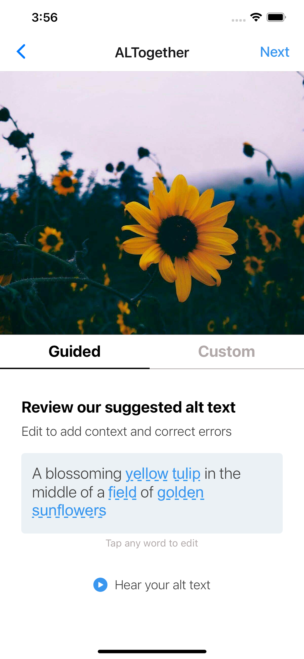
ALTogether
Creating richer, more reliable alt text
Problem
Blind and visually impaired users often feel frustrated with lack of focus, context, and emotion in auto-generated alt text on Instagram.
Solution
We provide sighted users a way to write quality alt text by modifying AI-generated suggestions on their images.
Design Iteration
Modify auto-generated alt text captions to add personalized context
Nudge your friends to add alt text captions
Find photos on your feed without alt text
Low-Fi
Med-Fi
High-Fi
CS147 Winter 2021
http://web.stanford.edu/class/cs147/projects/MultimodalInterfacestoBroadenAccess/ALTogether/
Haeli Baek | Danielle Cruz | Jung-Won Ha | Sydney Jones

